Slide 1
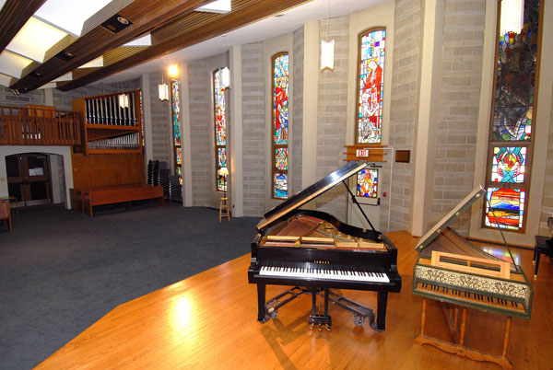
VCM Wood Hall
Venue Visual Story
Image from the Victoria Conservatory of Music

Slide 2
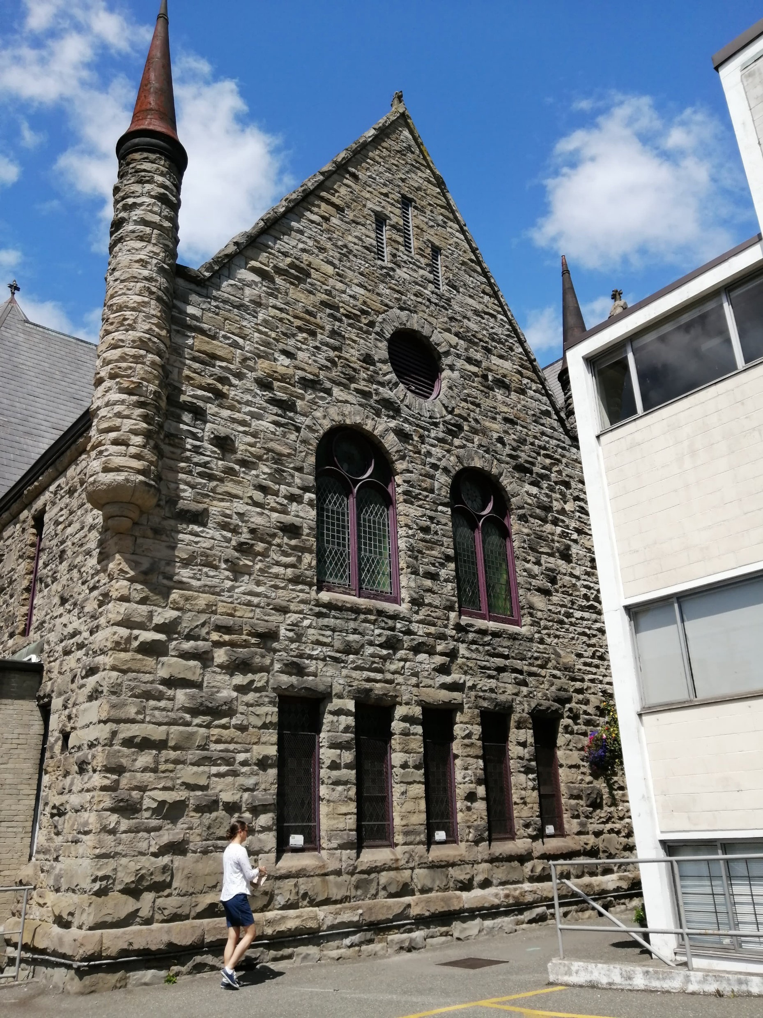
About Wood Hall
Wood Hall is part of the Victoria Conservatory of Music (VCM).
It is Venue #4 of the Victoria Fringe Festival.
It is located at 907 Pandora Avenue.
A view of the VCM from the parking lot on Johnson Street.

Slide 3
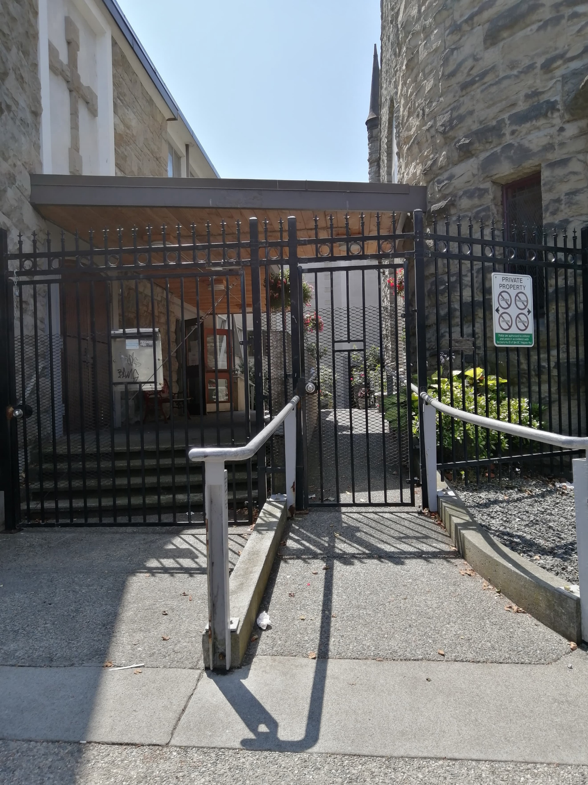
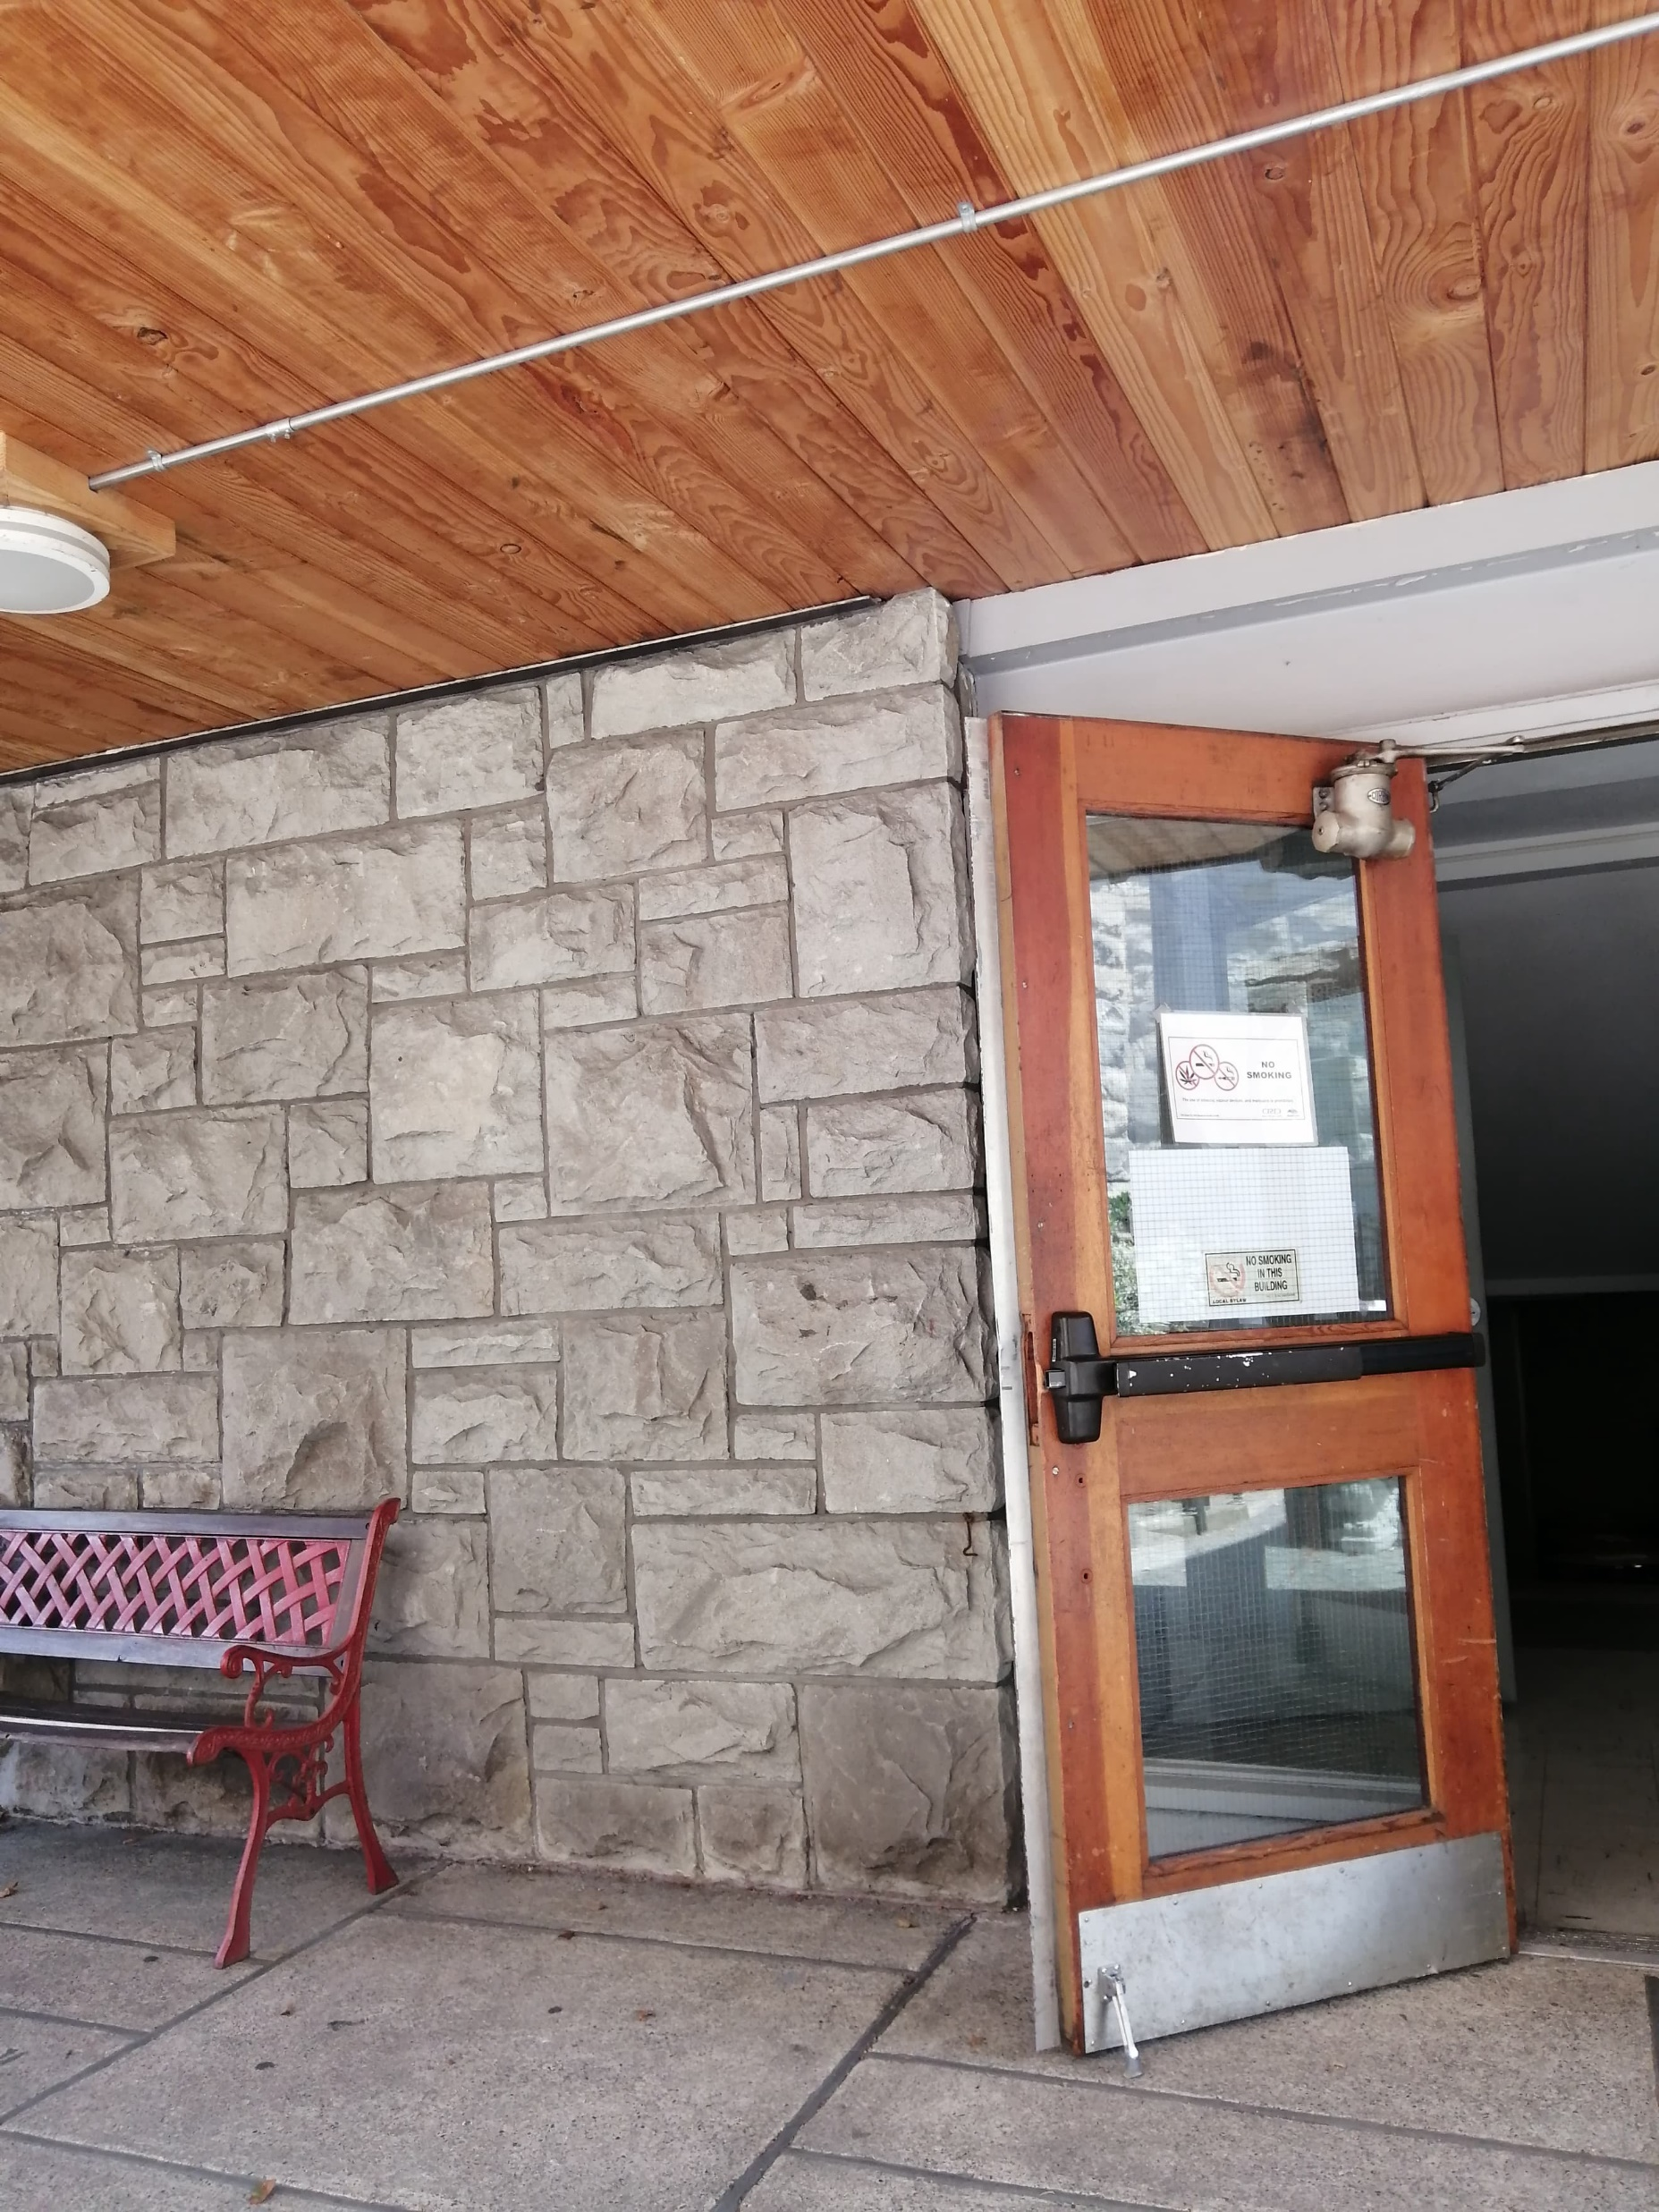
When you arrive
This is what the entrance looks like from Pandora Ave.
The box office will be outside the building.
The box office will be set up here.

Slide 4
The Wood Hall venue box office
You can purchase show tickets and Fringe buttons at the box office.
If you purchase tickets and buttons at the venue, it is cash only!
You need a Fringe button to get into any Fringe location, including Metro Studio Theatre. They are $6. Make sure your button is visible when you arrive!
This is what the Fringe buttons look like this year.

Slide 5
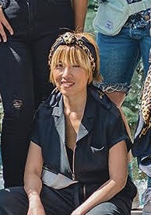
Checking in
If you have already bought your ticket and Fringe button, check in with the box office when you arrive.
If you need any accommodations (such as priority seating or a Theatre Buddy), please check in with the Front of House manager at least 25 minutes before the show starts.
This is June, the Front of House manager at Metro Studio Theatre.

Slide 6
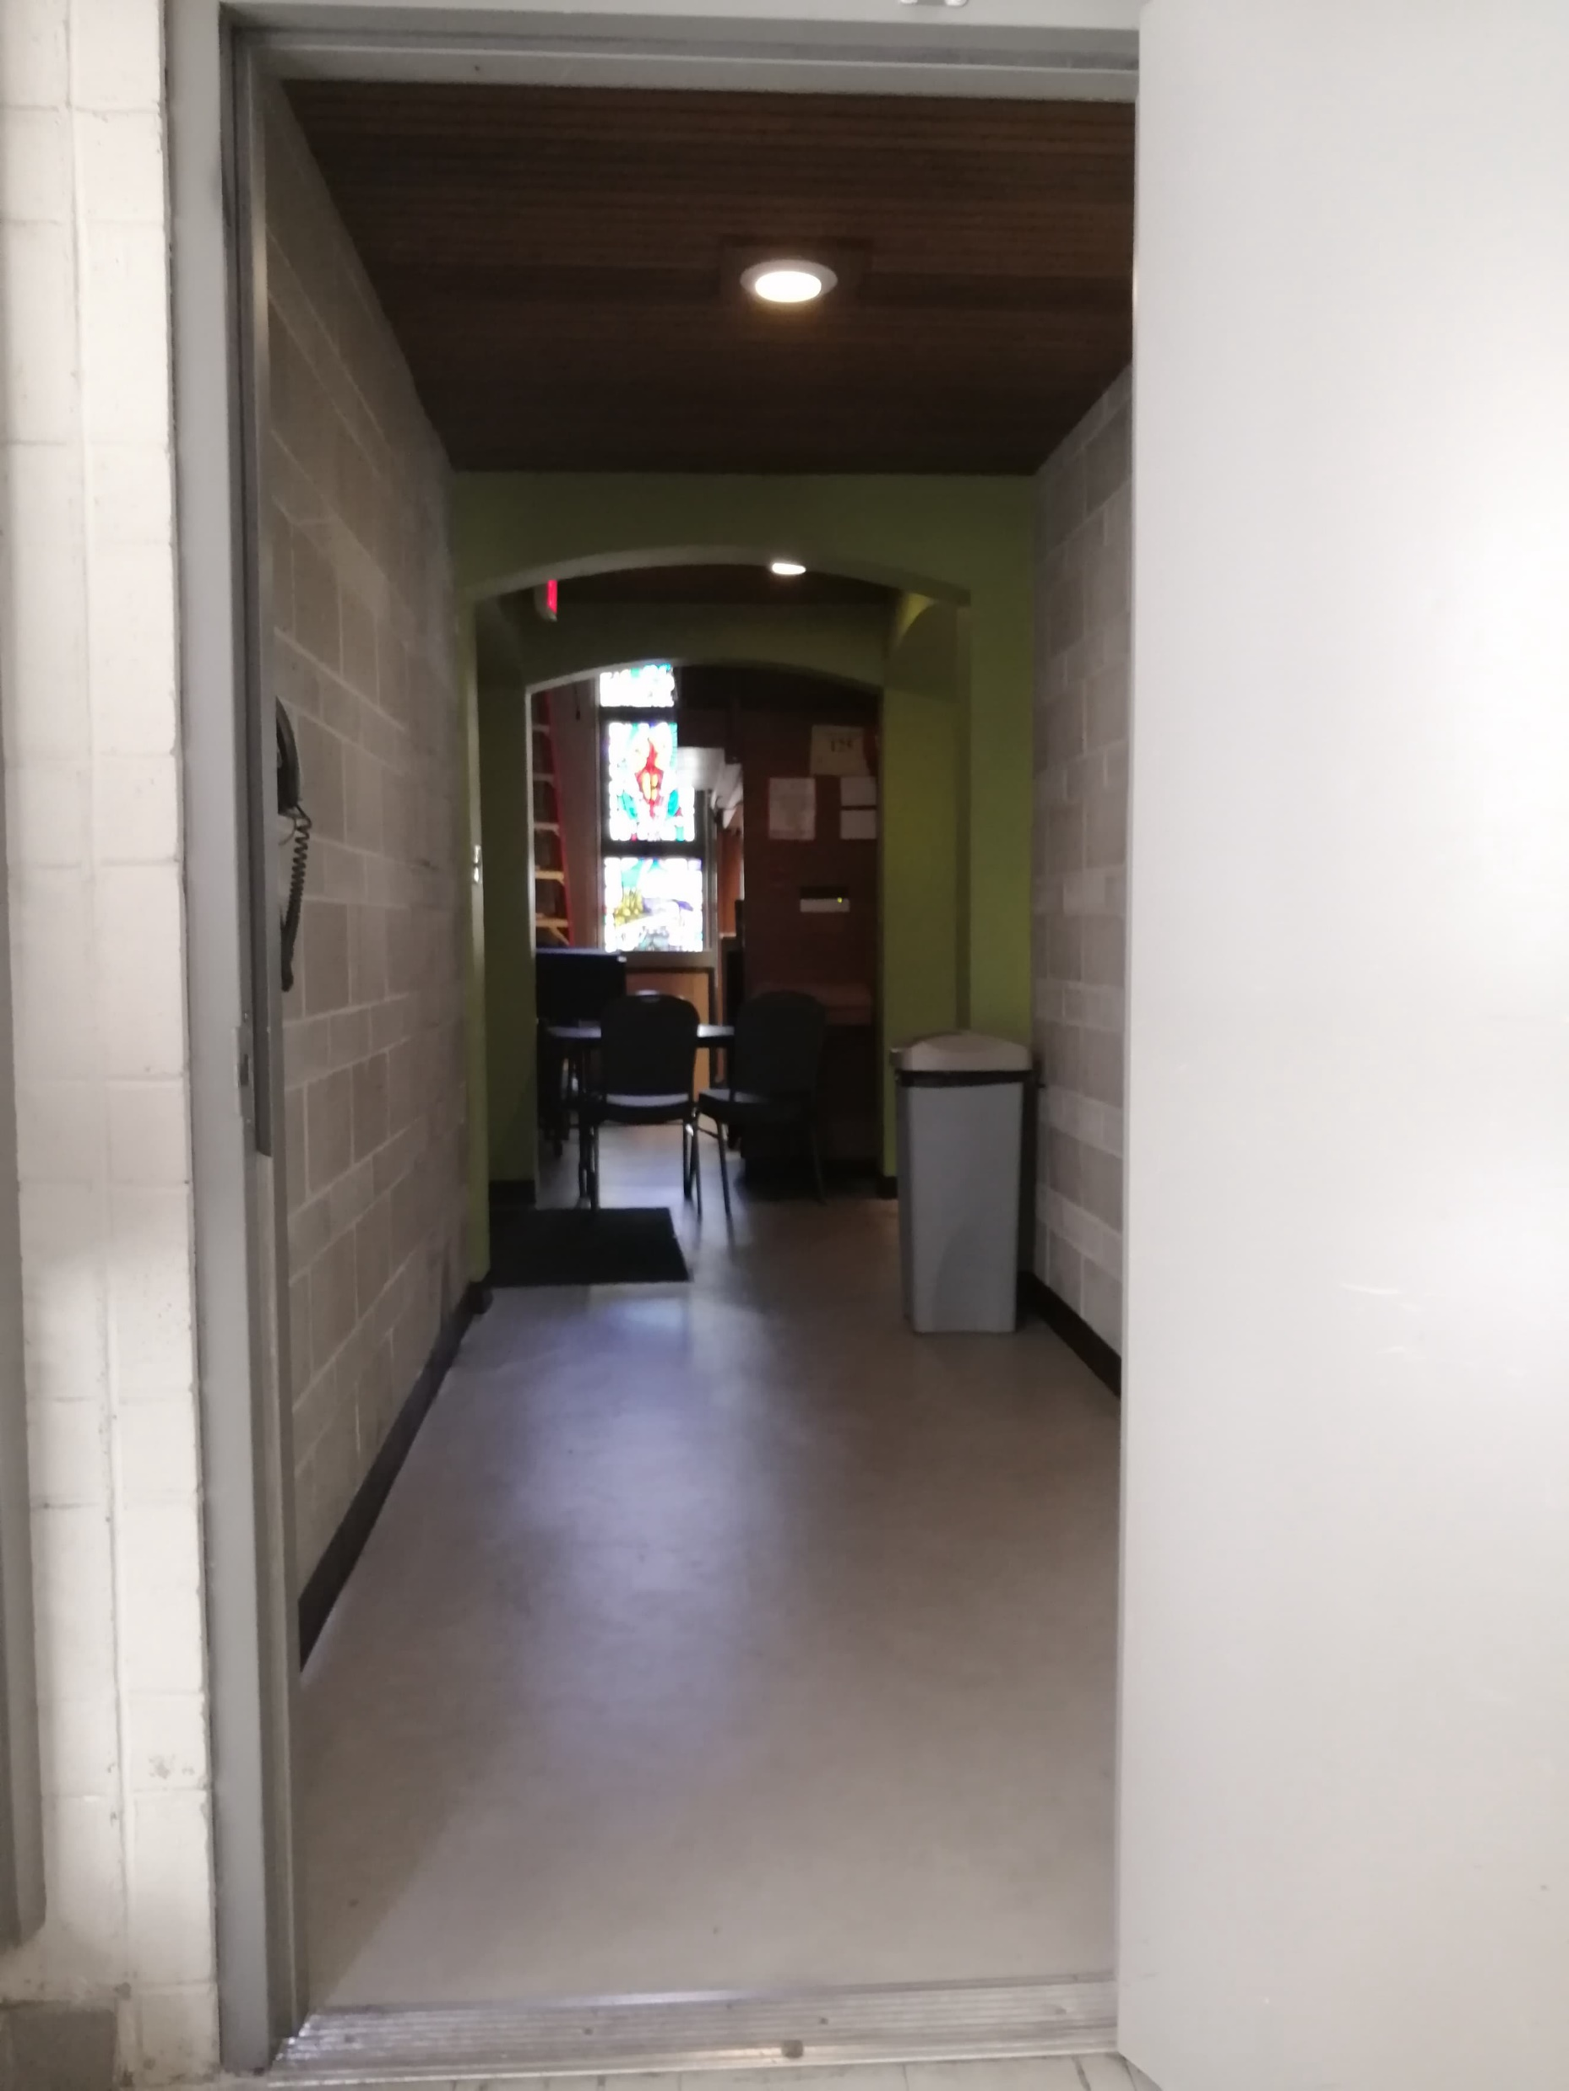
Entering Wood Hall
As soon as you enter the building, you will see this hall to the left.
This hall leads to the theatre (which is through a door on the right)
You will be allowed into the theatre 15 minutes before the show starts.

Slide 7
Inside the hall
This is what you will see when you enter the Hall
There will be seating set up in the empty space.
The stage will be set up at the front of the room (where there are drums and chairs in this photo).

Slide 8
Washrooms
Intrepid supports all trans and gender-variant people choosing the bathroom that feels most comfortable and safe for them at the Fringe Festival. Because some bathrooms are constructed differently, we have symbols and an explanation on the bathroom signs of what people can expect (e.g. A symbol for a stall, a urinal, accessible washroom etc.).

Slide 9
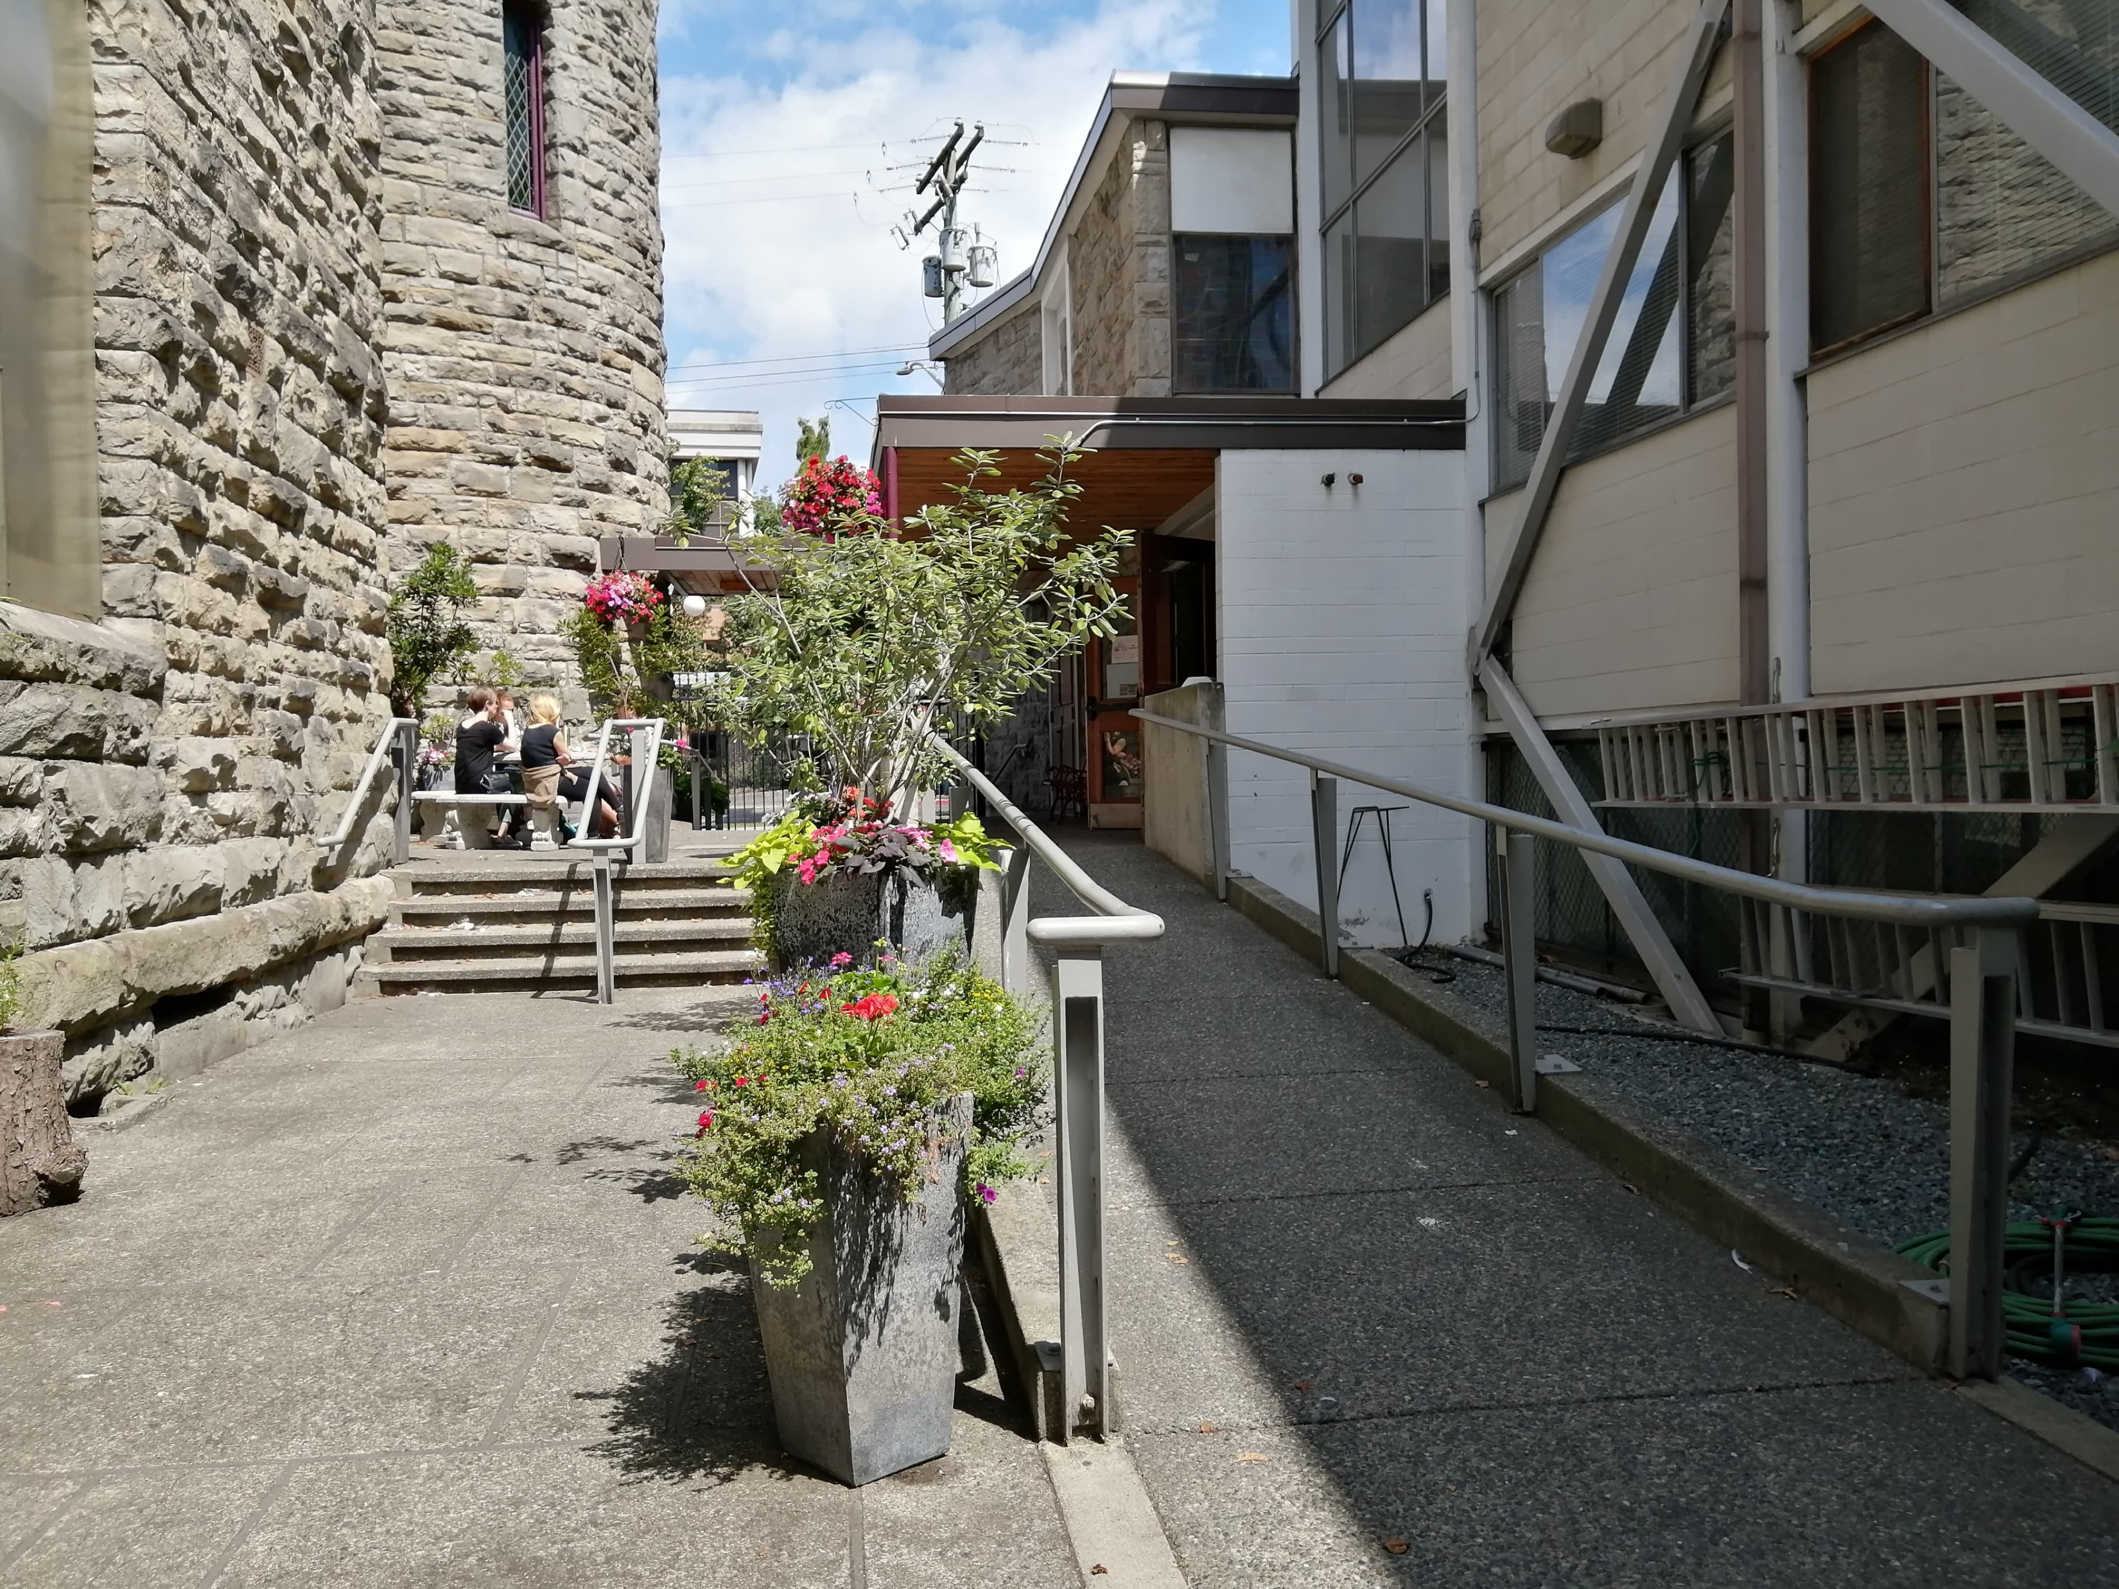
Washrooms
The washrooms are in the Victoria Conservatory of Music. To get there from Wood Hall:
Go down this ramp or these stairs.
The entrance to Wood Hall is here.

Slide 10
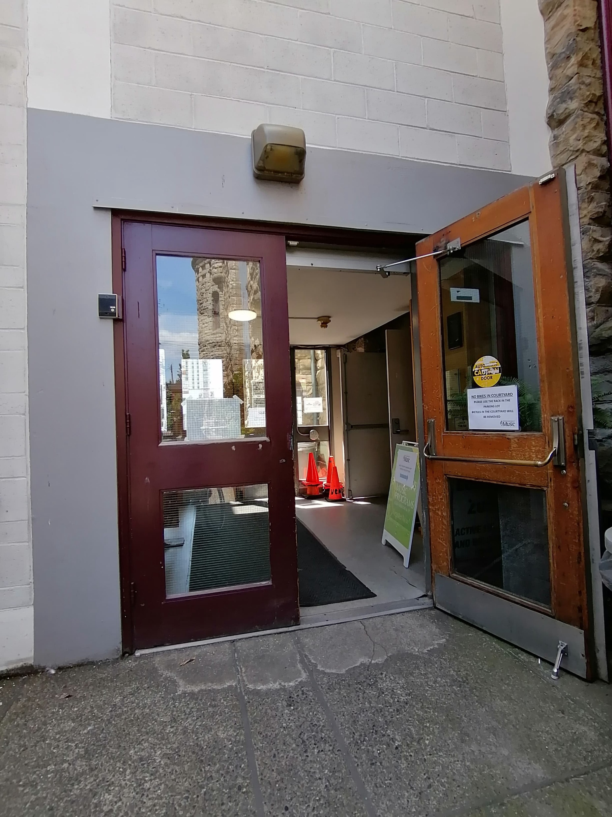
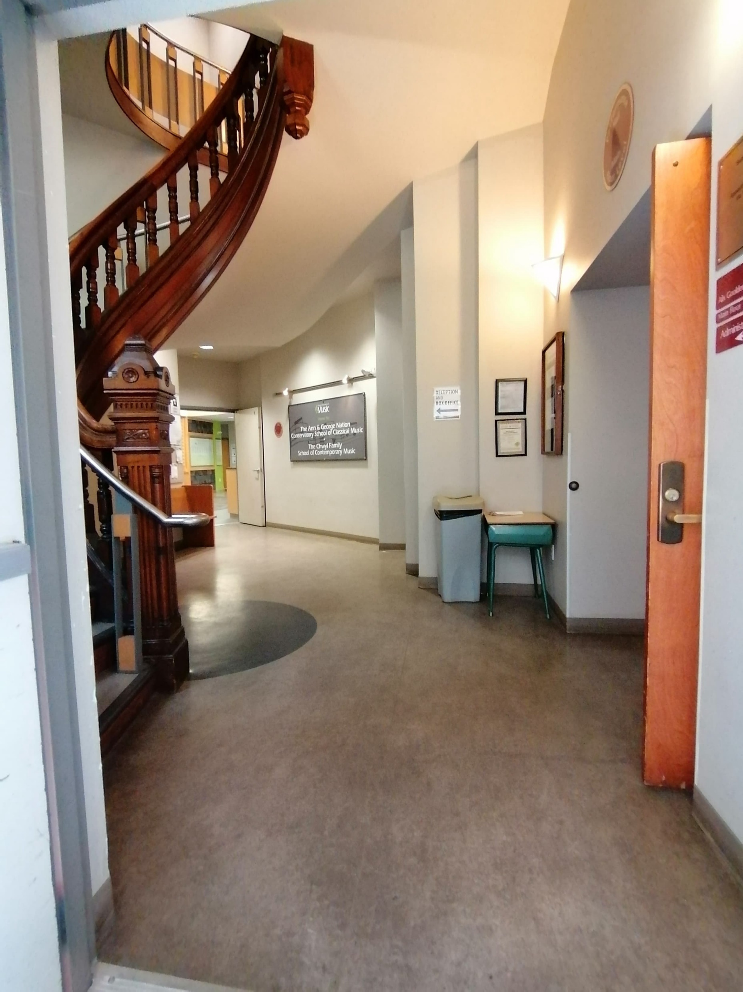
Washrooms
Once inside, turn right. You will see this hall:
Go through this door.
Go down this hallway.

Slide 11
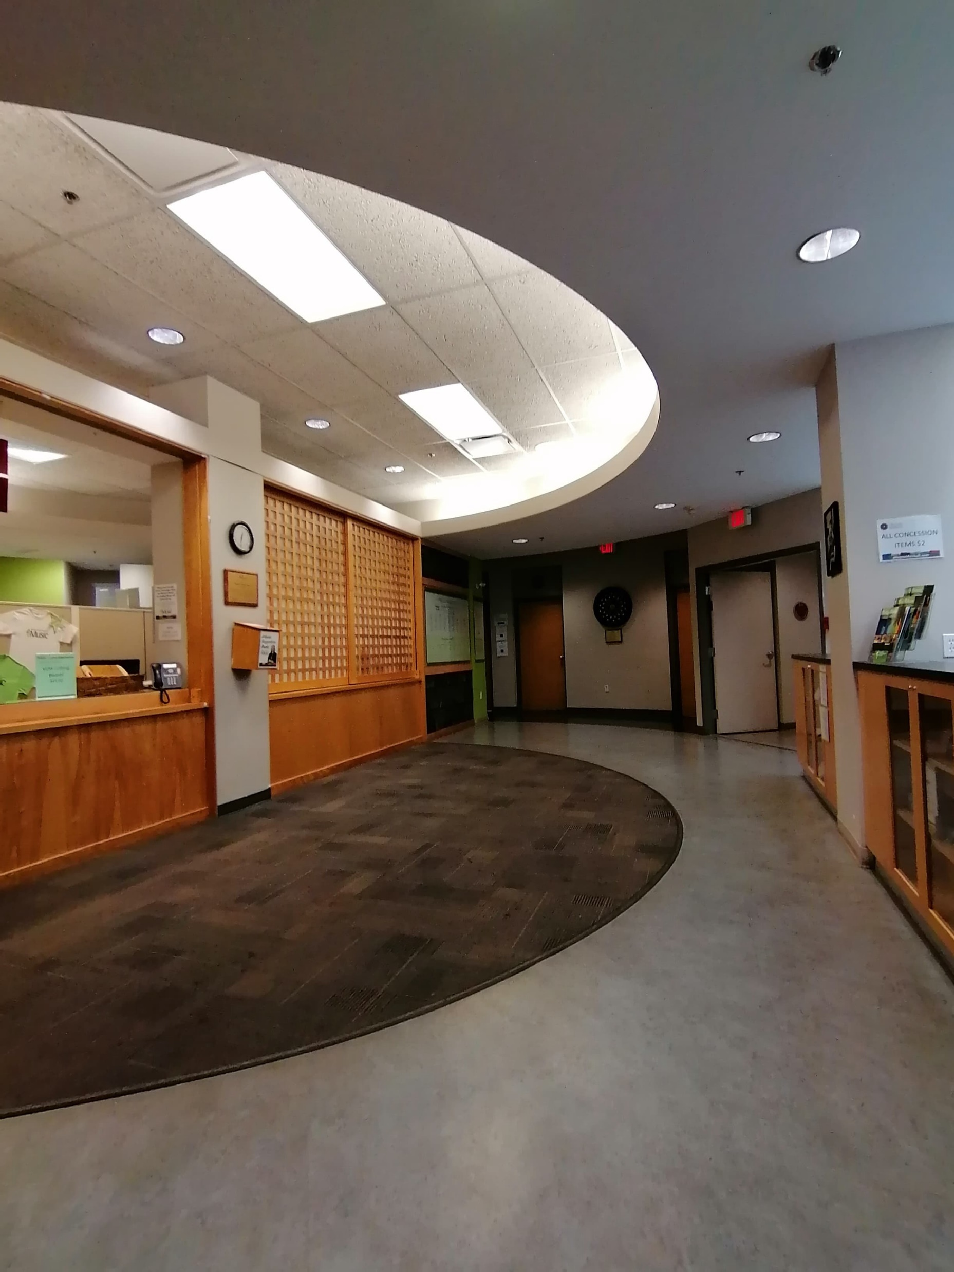
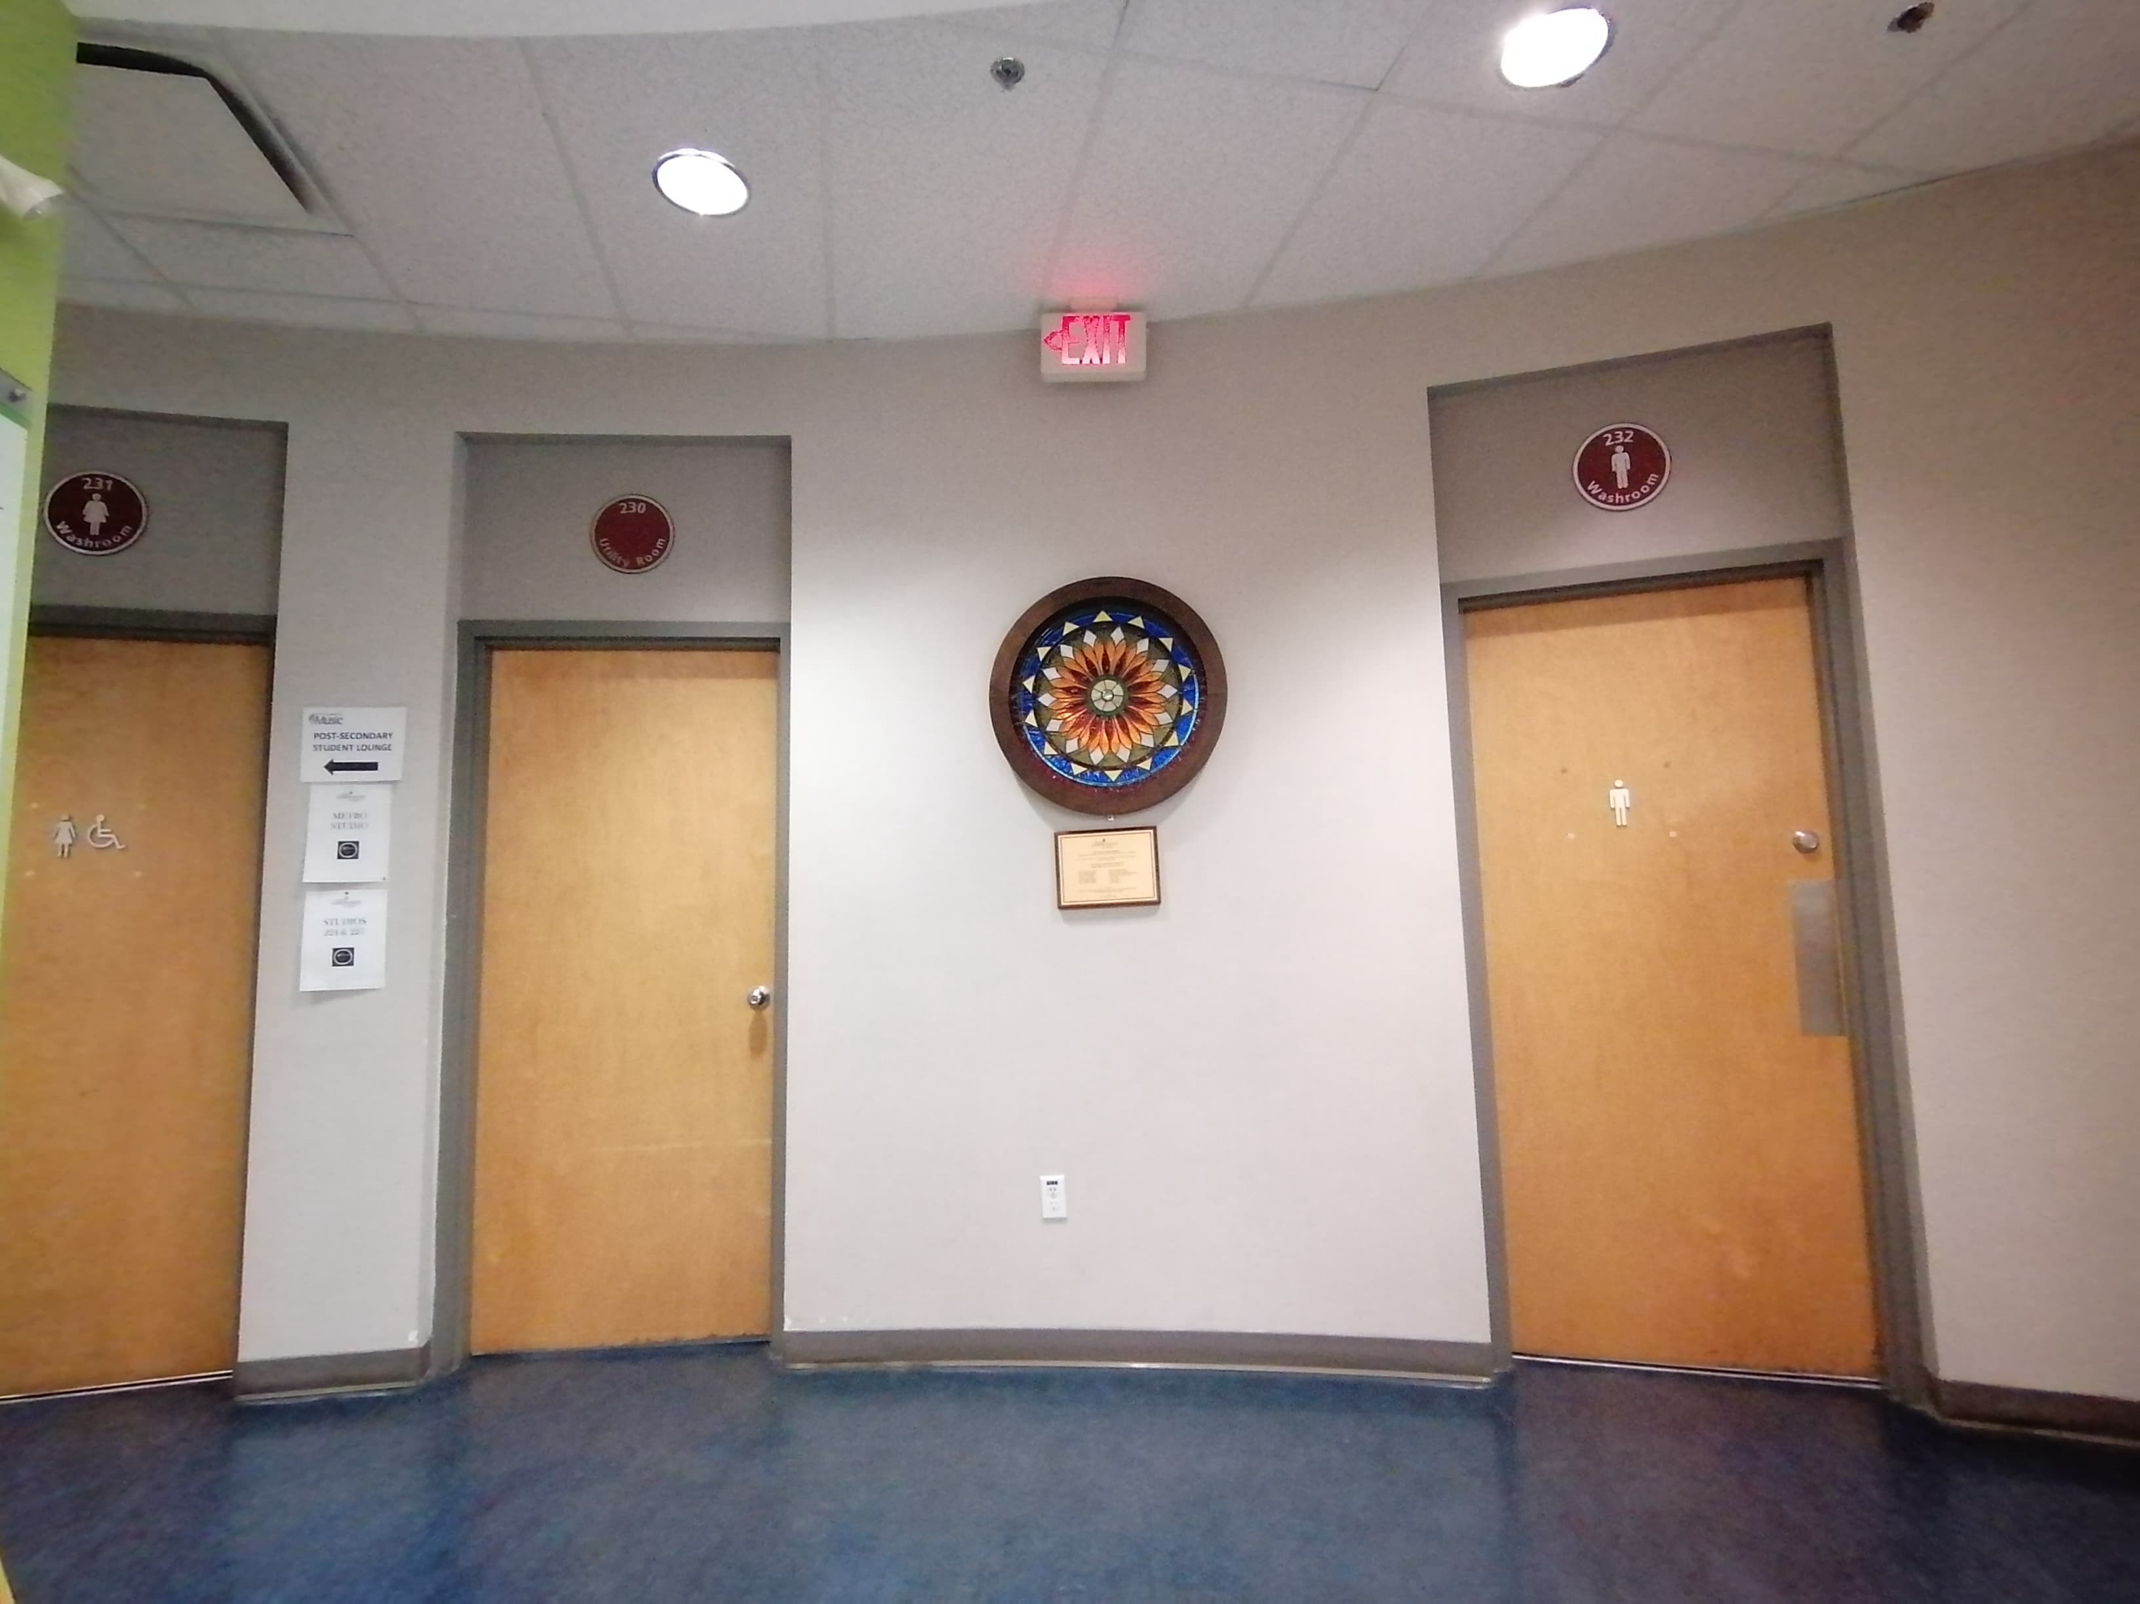
Washrooms
The washrooms are on the far side of the lobby. During Fringe, they will be designated all-gender washrooms.
At the end of the hallway, you will be brought into the VCM lobby.

Slide 12
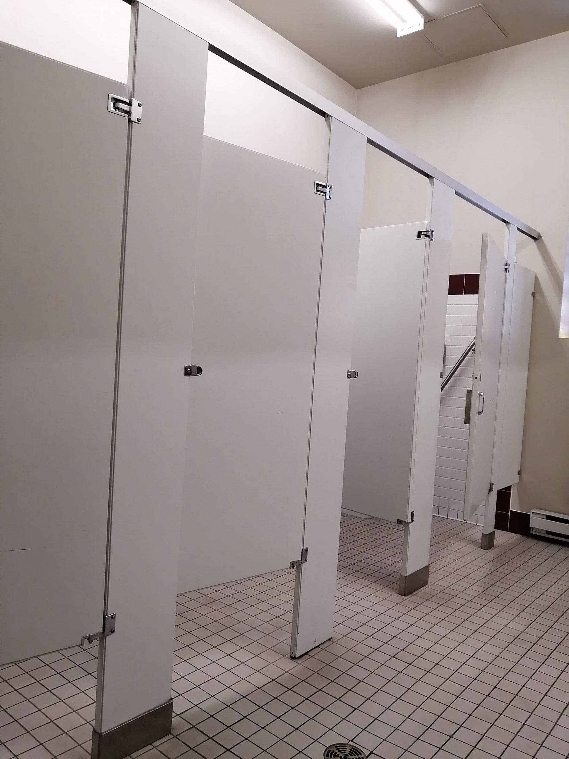
Washrooms
The washrooms have one accessible stall each.

Slide 13
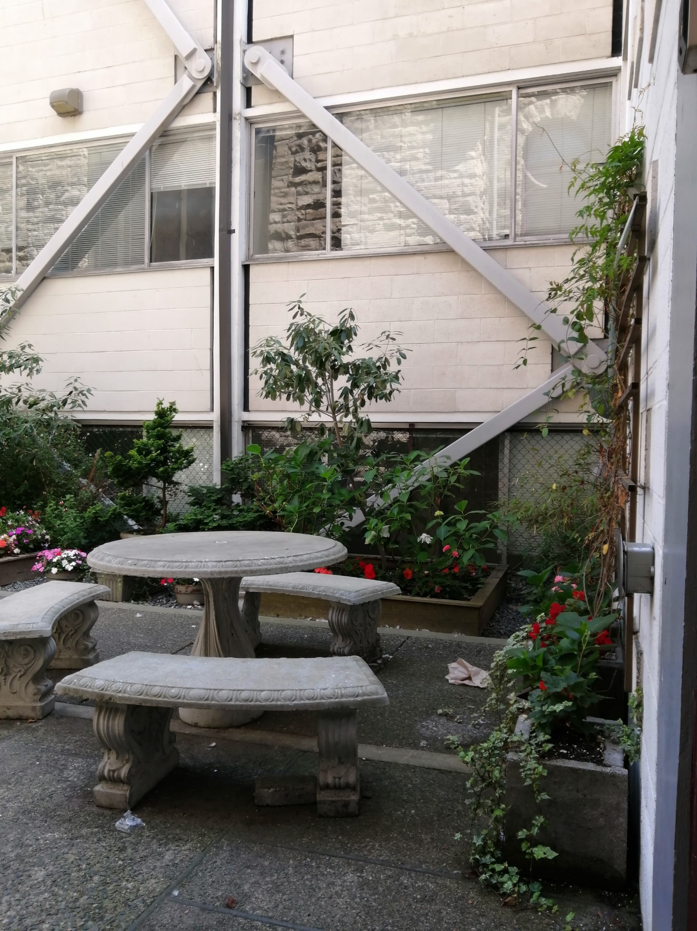
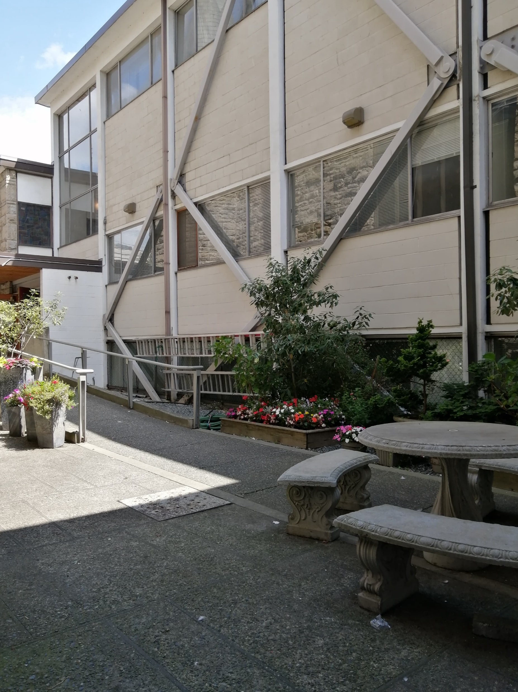
Chill space
There will be a chill space set up in the courtyard. This area will be available if you would like a quiet break at any point during the show.

Slide 14
What to expect at shows
Audience members will be allowed into the venue 15 minutes before the show starts. You can choose which seat you would like to sit in.
All Fringe shows start on time, and no latecomers are permitted. The only exception is at designated relaxed performances.
At the end of the show, people will clap. This shows appreciation for the artist. You can also wave your hands instead of clapping.
If you really enjoyed the performance and want to thank the artist, Fringe artists will often indicate if they will be around after the performance if you want to say hi or thank them.

Slide 15
What to expect at relaxed performances
There are several relaxed shows at Wood Hall this year. These performances create a relaxed environment by removing some elements of traditional theatre. Here are features of all of our relaxed performances:
Audience members may come and go as needed. If you need a break, feel free to use the chill space in the courtyard.
House lights are left on during the performance.
Sounds and lights are made less intense.
Some artists make additional measures to create relaxed performances. This information can be found on the Fringe website under accessibility.

Slide 16
Shows at VCM Wood Hall
Dear Samantha
All performances are relaxed.
Diagnose This! Tales of a Medical Actor
All performances are relaxed.
TravelTheatrics
Script is available to borrow from the venue or Fringe HQ on the corner of Blanshard and Fisgard.
SCAREDY CAT
Relaxed performance on August 24 at 3:30.
How I Murdered My Mother
Destiny, USA
All shows incorporate ASL videos and surtitles.
Fully ASL interpreted show on August 29 at 8.

Slide 17
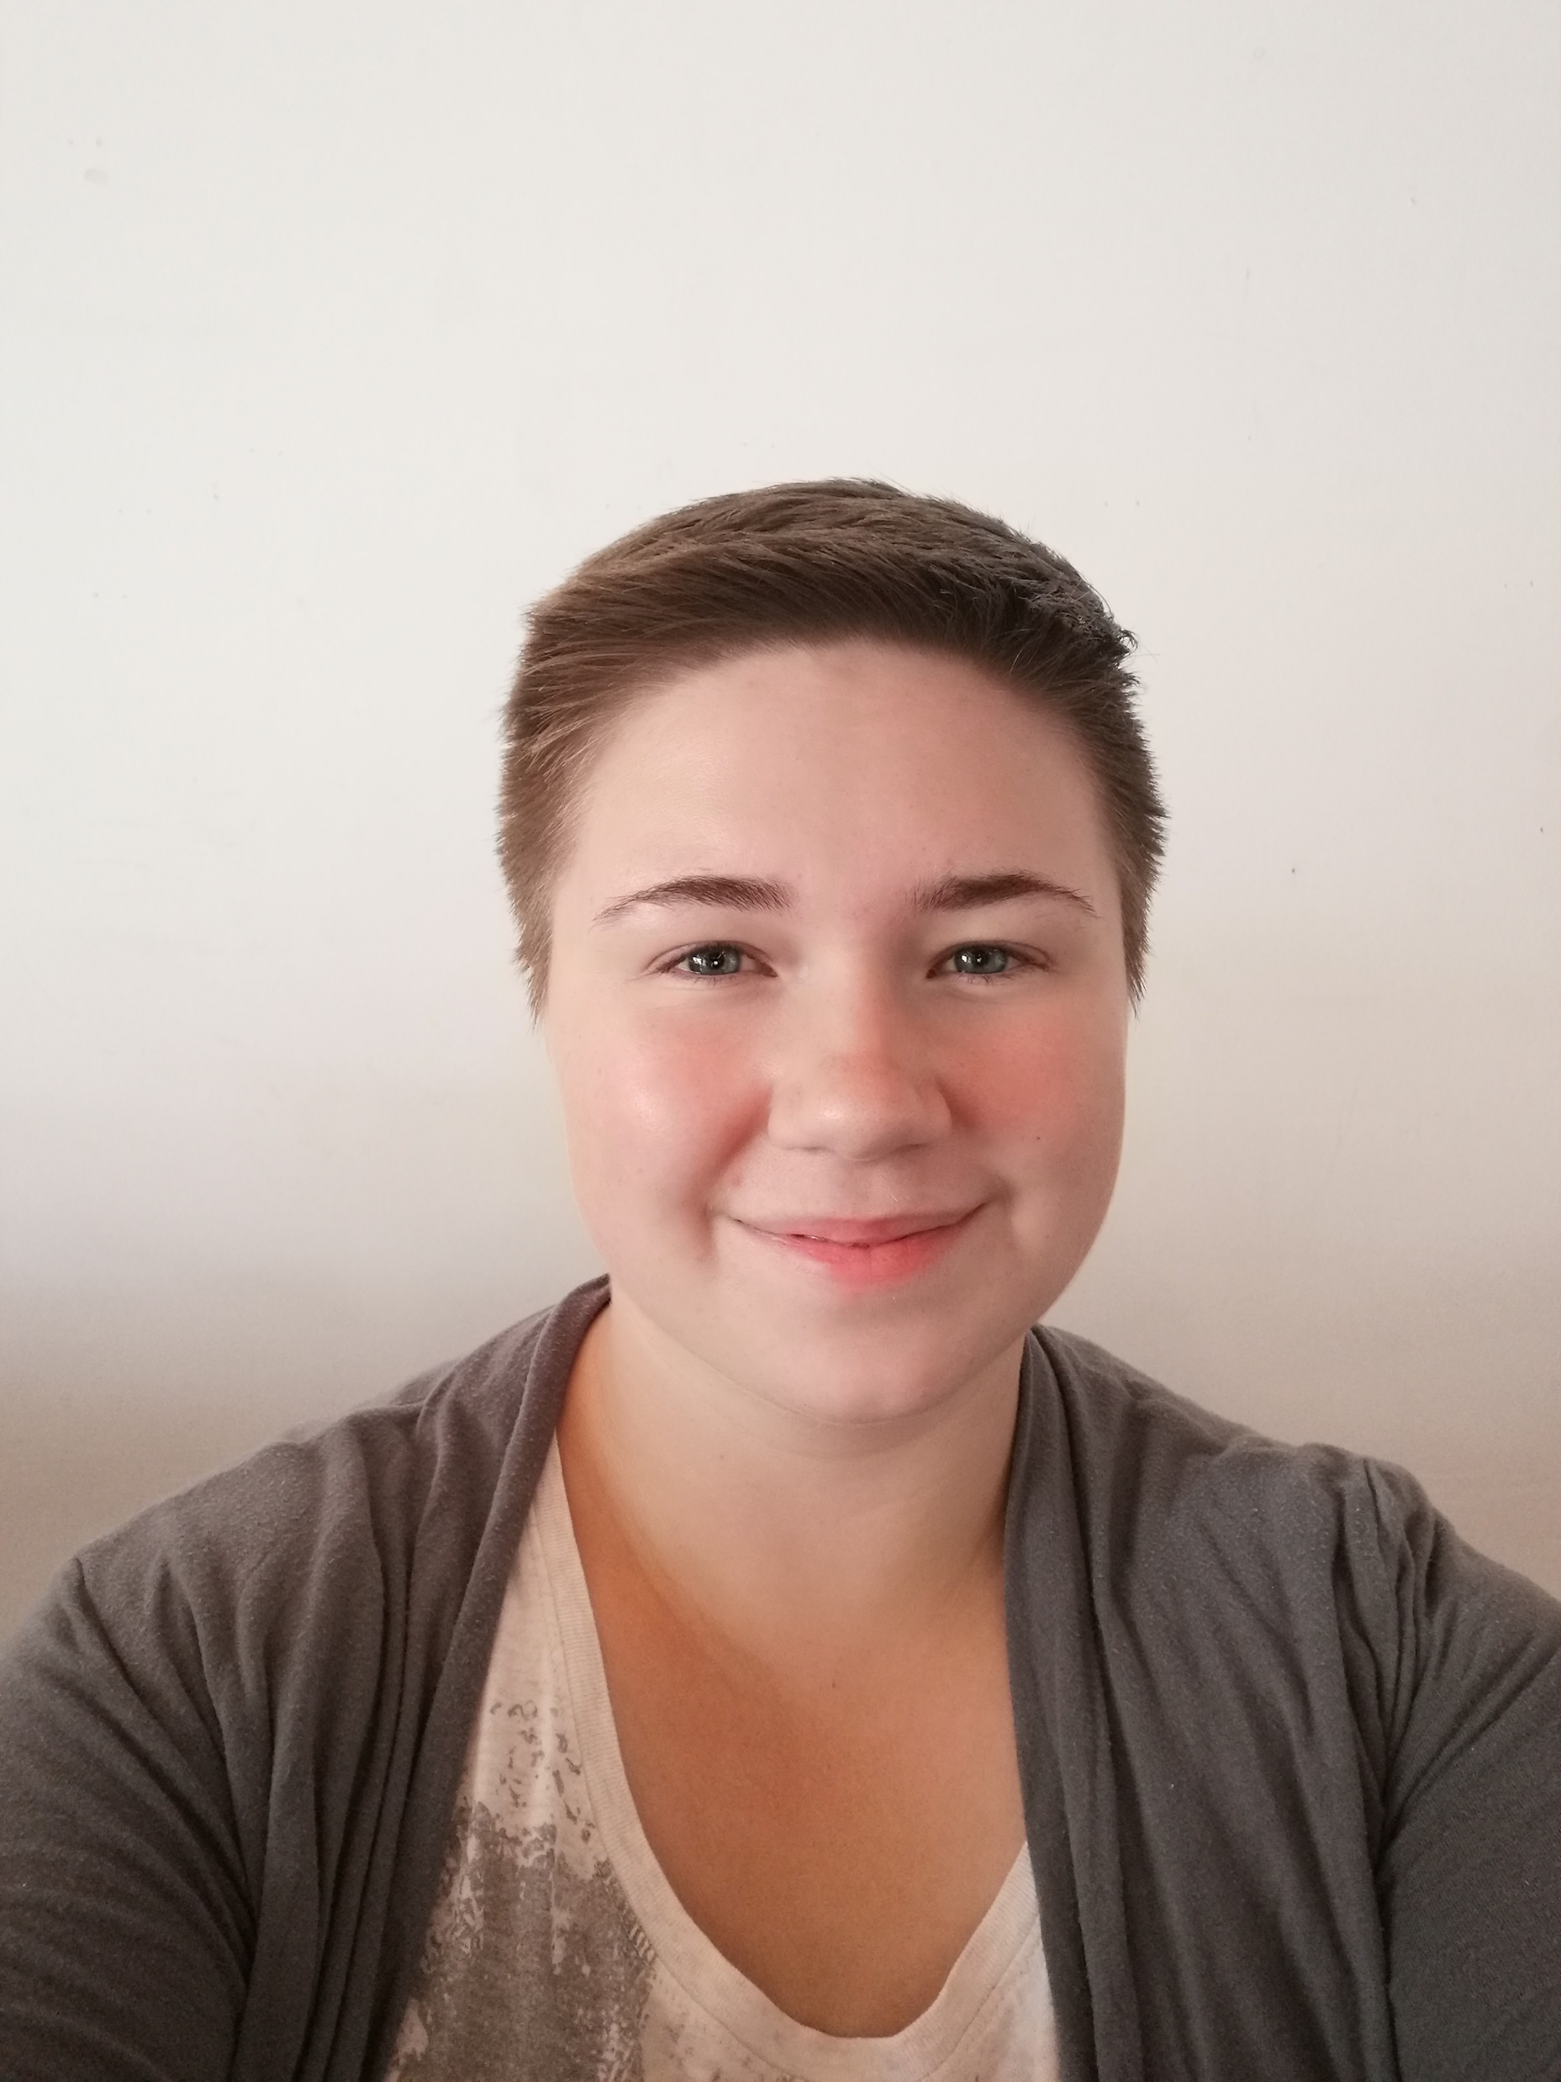
Questions?
If you have any questions about accessibility at Victoria Fringe, please go to the Fringe website, or contact our Accessibility and Outreach Coordinator, Navarra.
You can reach Navarra by calling 250-590-0394, emailing access@intrepidtheatre.com, or by coming in-person to Fringe HQ.
This is Navarra. She will be in the lobby of Fringe HQ.

